Slide 1
EXL_EQ_Case_Study_Round-2
Team : IIT Madras
College : IIT Chennai
Student 1 : Satish G
Student 2 : Uday theja

Slide 2
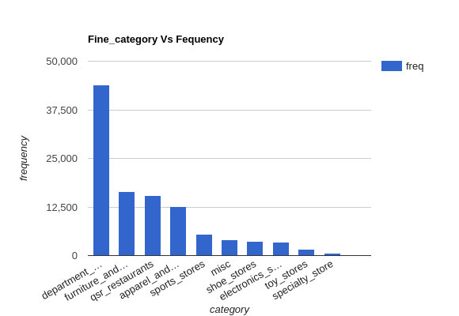
Shopping-complex layout optimization
Department_Stores, Furniture_and_Decor, Qsr_restaurants, Apparel_and_Accessories are the most visited categories with frequency over 10K.
The shops of above categories must be in the most accessible places of the mall.
In particular the below shops which are most visited in their respective category must given as much visibility & accessibility as possible:
(i)Department_Stores : Bloomingdale's, Brookstone, Nordstrom; (ii)Furniture_and_Decor : Kiehl's, Forever Flawless; (iii)Qsr_restaurants : Cafe Bellini, TAP 415, M.Y. China, Nordstrom E-Bar; (iv)Apparel_and_ Accessories : Claire's Boutique, OAK+FORT, Fossil, Victoria's Secret
Casual_restaurants, Office_Supply_Stores Cellular_Phone_Stores are least visited categories with frequency less than 100. The shops of these categories can be in the least accessible places of the mall

Slide 3
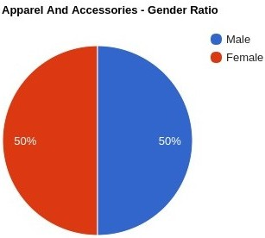
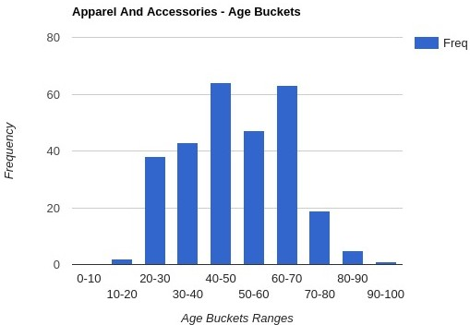
Patterns* seen across the Mall
The gender ratio for Apparel And Accessories Category is equal.
Hence the products must target both the genders equally
The most frequent visitors are in the age group 30-70.
In particular age group of 40-50 and 60-70 have a higher frequency
The products can target a wide range of 30-70 age group audience
*analysis only on the top 50% most visited customers

Slide 4
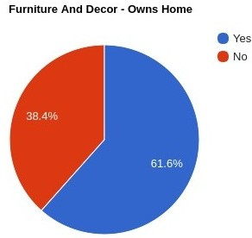
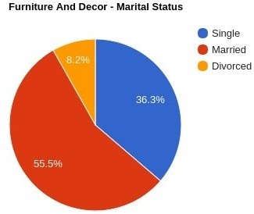
Patterns* seen across the Mall
The ratio of people owning a home for Furniture And Decor Category is more for those who own a home.
However, almost 40% of people who don't own a home are also frequent visitors.
Hence, the products must accommodate interests of mainly those who own a home
The Marital Status ratio of people owning a home is more for those who are Married, followed by Single.
Hence, the products must accommodate interests of mainly those who are Married
*analysis only on the top 50% most visited customers

Slide 5
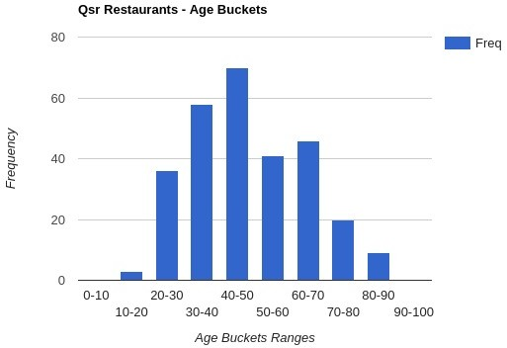
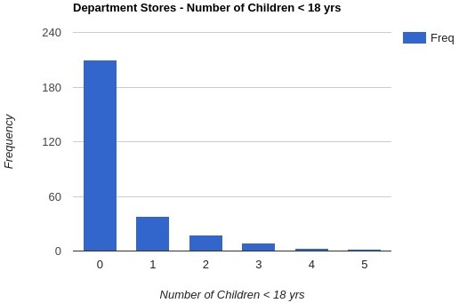
Patterns* seen across the Mall
The Age Buckets for Qsr Restaurants shows that the most frequent customers are in the age group 30-50.
Mainly, 40-50 age groups are the highest frequented customers.
50-70 and 20-30 age groups are also significantly frequented.
Hence the cuisines or menu could be tailored to serve mainly 30-50 age groups, followed by 50-70 and 20-30
The Number Of Children < 18 yrs frequency of most frequent customers for Department Stores shows that customers with no children are most frequented.
There is a huge margin between No Children group and the others
Hence, the Department Stores need not target Children's products
*analysis only on the top 50% most visited customers

Slide 6
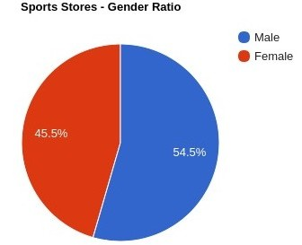
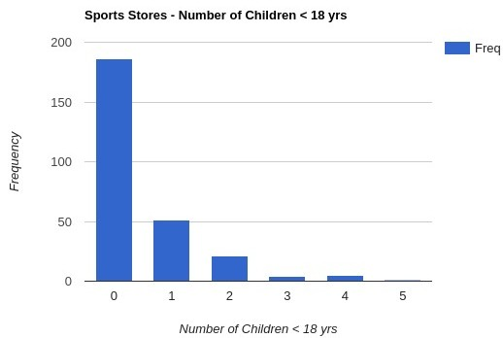
Patterns* seen across the Mall
Male ratio is high in Sports Stores
However, almost 46% of female customers also frequent visitors.Hence, the products must accommodate interests of mainly Male customers but not show much bias against the Female customers
The Customers with no children are most frequented.
There is a huge margin between No Children group and the others
Hence, the Sports Stores need not target Children's products specifically.
*analysis only on the top 50% most visited customers

Slide 7
Further Refinements
The current inferences can further be refined by looking at the demographics like Number Of Children for each Customer to infer whether the products being bought by the customer are for himself or his/her children.
We can analyse the timestamps of most frequented customers to infer if there is a seasonal pattern in his visits and reach out individually to prospective customers with attracting offers timely.
We tried to find a common subset of categories or shops visited by all the customers and we inferred that there is no common subset across all the customers. Instead we could find a common subset across top 50% or so of most frequented customers and highlight those shops or categories more.

